Slide 1

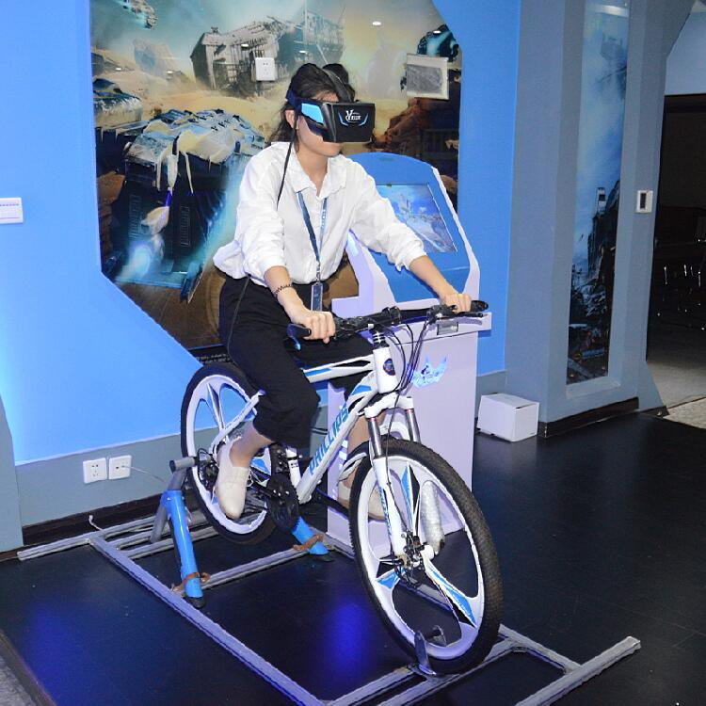
Competitive Virtual Cycling Over 5G
Group members:
180639P - T.A.D.S. Thennakoon
180236D - H.A.D.G. Hettiarachchi
180288L - D.S.B.C.L. Jayaweera
180316A - U.W.R.A.L. Karunathilaka
Supervisor – Prof. Dileeka Dias
Co-supervisor – Dr. Kasun Hemachandra

Slide 2

The Problem Statement
Health, fitness, and weight are major issues among people
Safety and comfortable issues in outdoor
Outdoor cycling takes a lot of time
Lack of platforms for virtual competitive cycling

Slide 3
Primary Objectives
Time-efficient high-energy workouts
Safer and more comfortable environment
High-intensity interval training
Competitive cycling experience at different geographical locations
Immersive experience
Visualization of the user’s competition statistics and health details

Slide 4
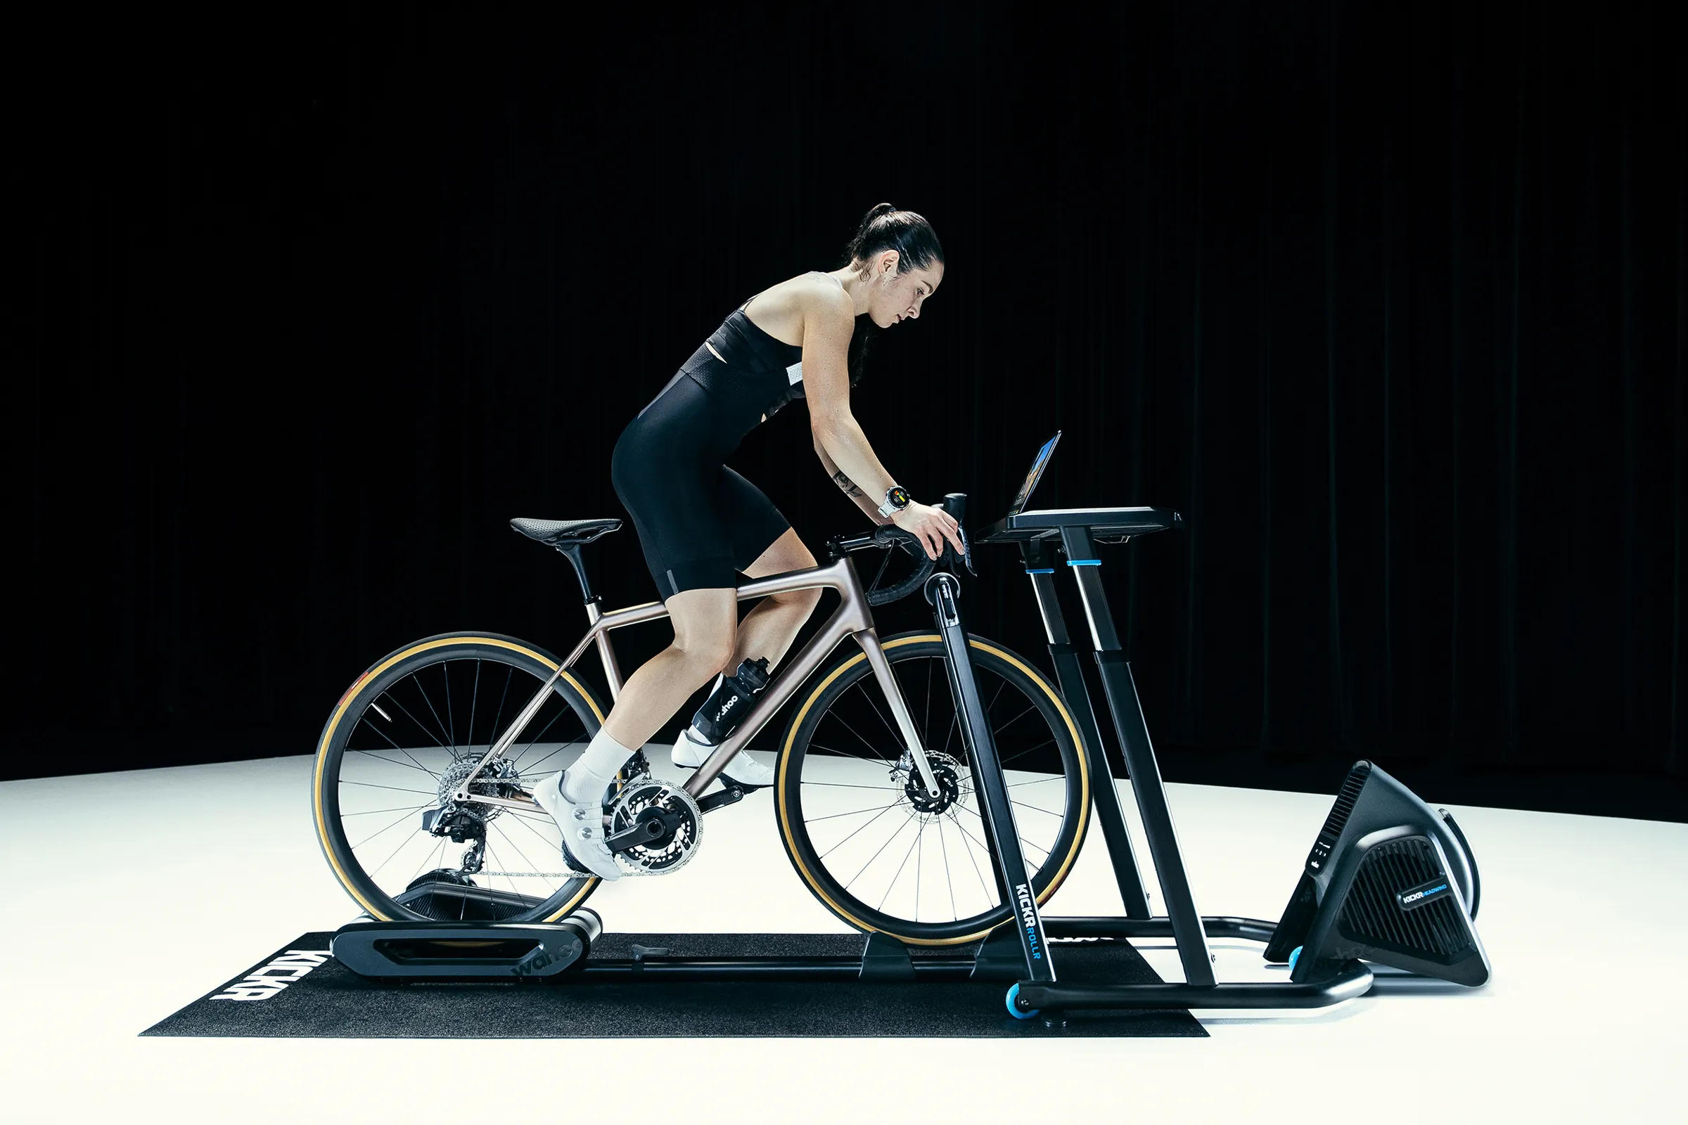
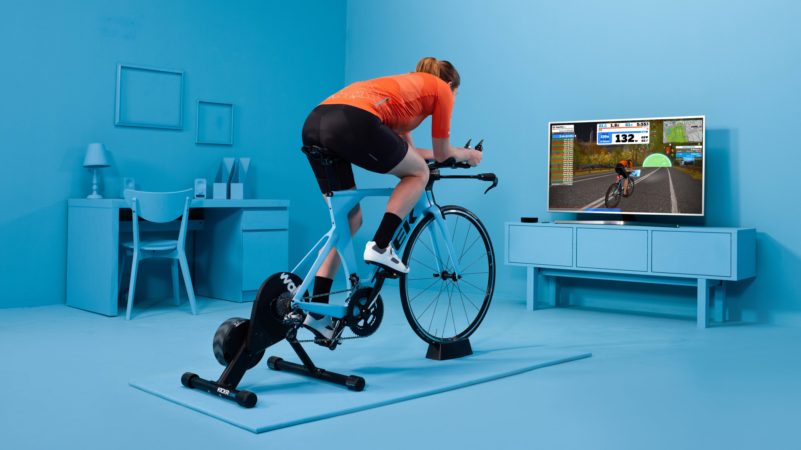
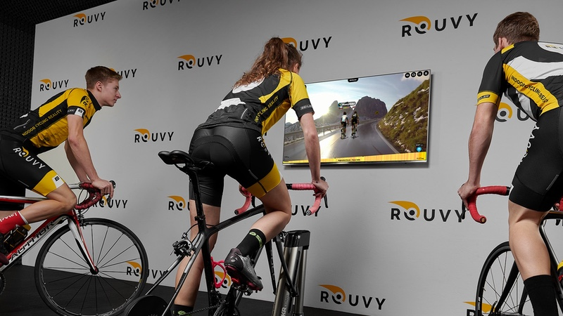

Current Implementations
Service Provider | Wahoo | Zwift | Rouvy | VZFIT
Immersive Experience | Not available | Available | Not available | Available
Competing with Others | Available | Available | Available | Available
Cycling Environment | Artificial | Artificial | Real-world | Artificial

Slide 5
Project Scope
Rendering and streaming a 360-degree video in the cloud
5G technology is used to achieve low latency and high bandwidth requirements
The relative position between competitors is calculated based on the outputs of the gyroscope
Web dashboard to show user’s competition statistics and health details

Slide 6
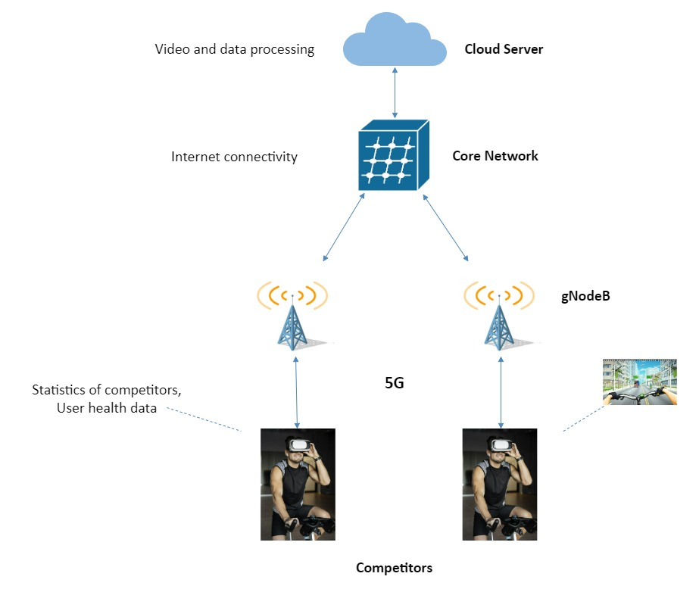
Proposed Architecture

Slide 7
Literature Review
5G Network
Why 5G?
Ultra-reliable low latency
Network slicing
Available 5G network options
Dialog 5G network established in the university (5G NSA)
Software-defined radio-based network (5G SA) ¹
1 https://gitlab.eurecom.fr/oai/cn5g/oai-cn5g-fed/-/blob/master/docs/DEPLOY_HOME.md

Slide 8
Literature Review Ctd.
Video optimization techniques ²
Dynamic adaptive HTTP streaming (DASH) ³
Tiling
Viewport adaptive streaming ⁴
Communication protocols that can be used for video streaming
MPEG-DASH
HLS
3D object positioning
Unity gaming engine for 3D object modeling and positioning
Spatial Augmented Reality for Computer generated graphics ⁵
2 https://doi.org/10.3390/app12157581
3 https://doi.org/10.3390/app10217691
4 https://doi.org/10.1145/3241539.3241565
5 https://doi.org/10.1016/j.procs.2019.01.120

Slide 9
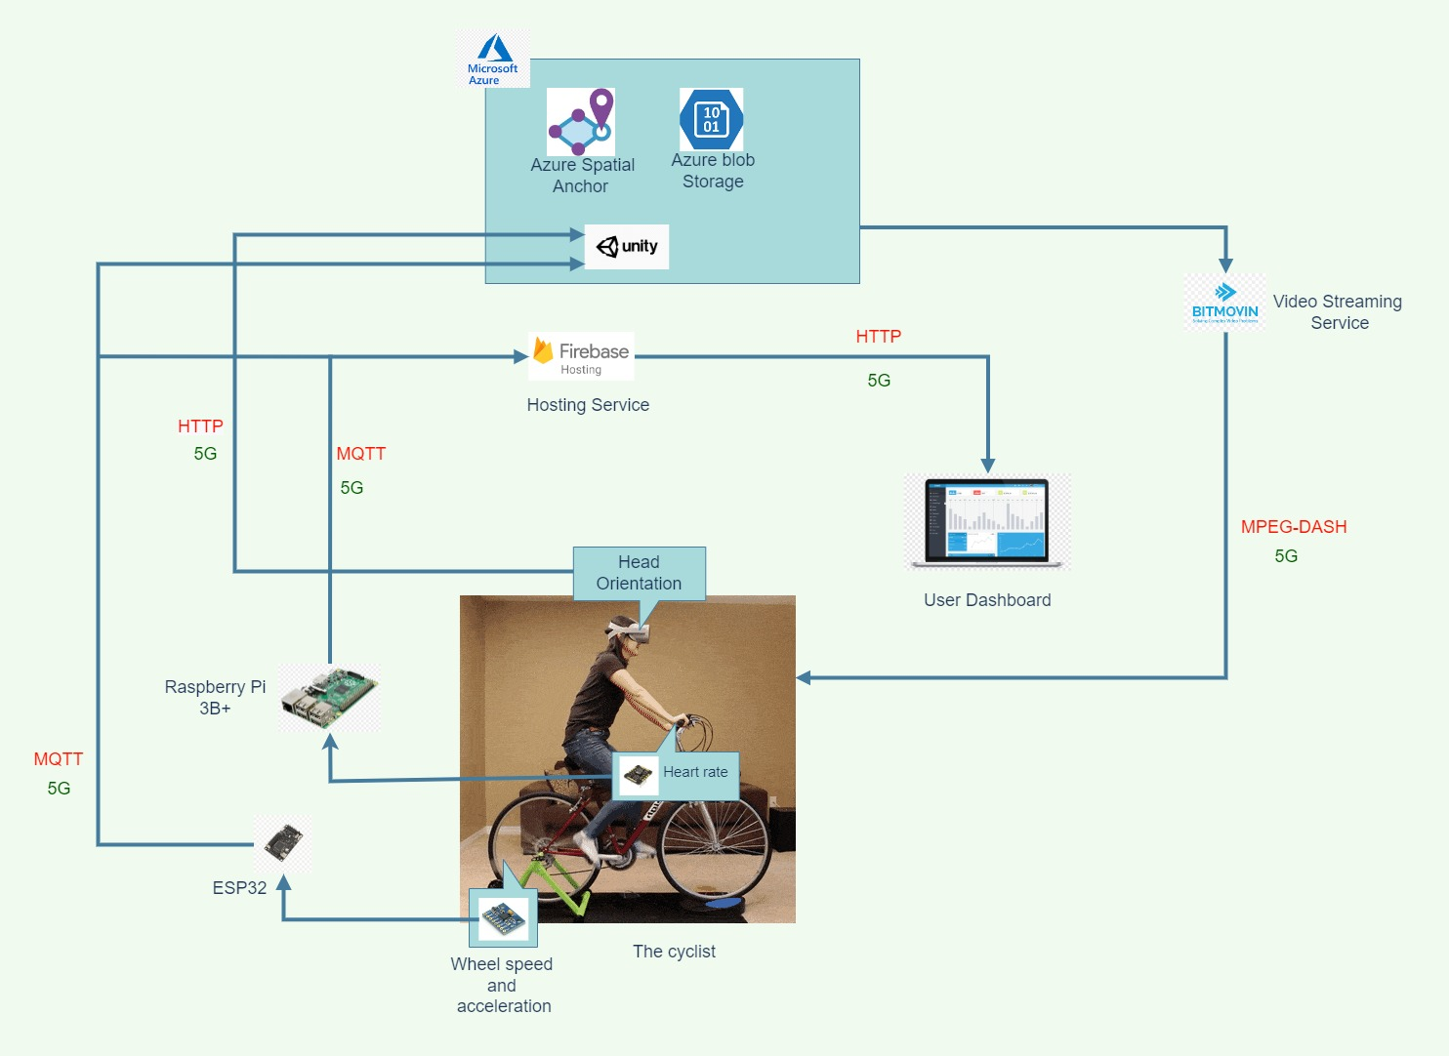
System Architecture

Slide 10
Performance Evaluation
Process | Target (delay in ms) ⁶
Sensor data transmission to the unity gaming engine | 120
Video processing in unity | Depends on the application (expected = 100)
Rendering and streaming | 100
 | Total = 320
The required bandwidth for 8k resolution videos > 100Mbps
The accuracy of positioning depends on sensor delay and the nature of the video environment.
6 https://www.huawei.com/minisite/pdf/ilab/cloud_vr_network_solution_white_paper_en.pdf

Slide 11
Business Opportunities
There are multiple user groups that connect with the platform
360 Video Providers
Game Centers
Fitness Centers
Cyclists
An opportunity to promote Sri Lankan tourist sites.
Currently there are no competitive virtual cycling platform providers in Sri Lanka.

Slide 12
Social Aspects
Cycling has become very popular.
An Alternative method to explore the world for those who cannot afford to travel to other countries.
More comfortable environment.
Reduced level of risk of outdoor cycling.
Indirectly support to reduce heavy traffic.

Slide 13
Alternative Strategies
Method | Advantages | Disadvantages
Video processing and game processing in a local server | Don’t need cloud servers Cost is low | Need devices that contain huge processing capabilities. High power consumption Low device durability
Video processing and game processing in a cloud Server | Simple end-user devices Low power consumption High device durability | Cost is high

Slide 14
Risk Factors
Risks in Project Implementation
Social and Financial Risks
Latency and bandwidth issues
Motion sickness
Lack of awareness about virtual reality among people
High cost for the product
Limited customer base

Slide 15
Approximate Budget
Item/Service | No: of Units | Cost Per Unit (Rs) | Total Cost (Rs) | Availability
VR headset (Oculus) | 2 | $478 (Rs. 172,500) | 345,000 | One is available
Bicycle | 2 | 40,000 | 80,000 | Available
Sensors (2 MPU6050 modules, 2 MAX30102 modules) | 4 | 1,000 | 4,000 | Available
Raspberry pi | 2 | $178 (Rs. 64,000) | 128,000 | Available
ESP32 | 2 | $17 (Rs. 6,000) | 12,000 | To be purchased
Service | Monthly Charge | No: of Months | Total Cost (Rs) | Availability | Remarks
Video Streaming Platform | $149 (Rs. 53,000) | 1 | 53,000 | To be purchased | Free-tier versions can be used during the implementation period
Azure cloud services | $50 | 6 | 18,000 | To be purchased
Total = Rs. 640,000

Slide 16

Task Delegation
Task | Dilun | Dulsara | Aruna | Lakshan
Feasibility Study
Literature Review
5G Environment Setup
Mobile App Development
Cloud Services
Video Rendering and Streaming
3D Positioning & Gaming Engine
Web Dashboard
PCB Designing
Solidworks Design
Prototyping and Demonstration
Working on a Publication
Documentation

Slide 17
Proposed Timeline
 | Task |  |  |  | 2022 Sep | 2022 Oct | 2022 Nov | 2022 Dec | 2023 Jan | 2023 Feb | 2023 March | 2023 Apr | 2023 May
 | Feasibility Study
 | PCB Designing
 | Setting up Cloud Platform
 | Setting up 5G Network
 | Mobile App Development
 | Platform for Single User
 | Object Positioning
 | User Dashboad
 | Testing and Optimization
 | Platform for Two User
Milestones
Proposed time period

Slide 18
References
[1] https://gitlab.eurecom.fr/oai/cn5g/oai-cn5g-fed/-/blob/master/docs/DEPLOY_HOME.md
[2] Wong, E.S.; Wahab, N.H.A.; Saeed, F.; Alharbi, N. 360-Degree Video Bandwidth Reduction: Technique and Approaches Comprehensive Review. Appl. Sci. 2022, 12, 7581. https://doi.org/10.3390/app12157581
[3] Gohar, A.; Lee, S. Multipath Dynamic Adaptive Streaming over HTTP Using Scalable Video Coding in Software Defined Networking. Appl. Sci. 2020, 10, 7691. https://doi.org/10.3390/app10217691
[4] Feng Qian, Bo Han, Qingyang Xiao, and Vijay Gopalakrishnan. 2018.Flare: Practical Viewport-Adaptive 360-Degree Video Streaming for Mobile Devices. In MobiCom ’18: 24th Annual Int’l Conf. on Mobile Computing and Networking, Oct. 29śNov. 2, 2018, New Delhi, India. ACM, New York, NY, USA, 16 pages. https://doi.org/10.1145/3241539.3241565
[5] Egils Ginters, Augmented reality use for cycling quality improvement, Procedia Computer Science, Volume 149, 2019, Pages 167-176, ISSN 1877-0509, https://doi.org/10.1016/j.procs.2019.01.120
[6] https://www.huawei.com/minisite/pdf/ilab/cloud_vr_network_solution_white_paper_en.pdf

Slide 19
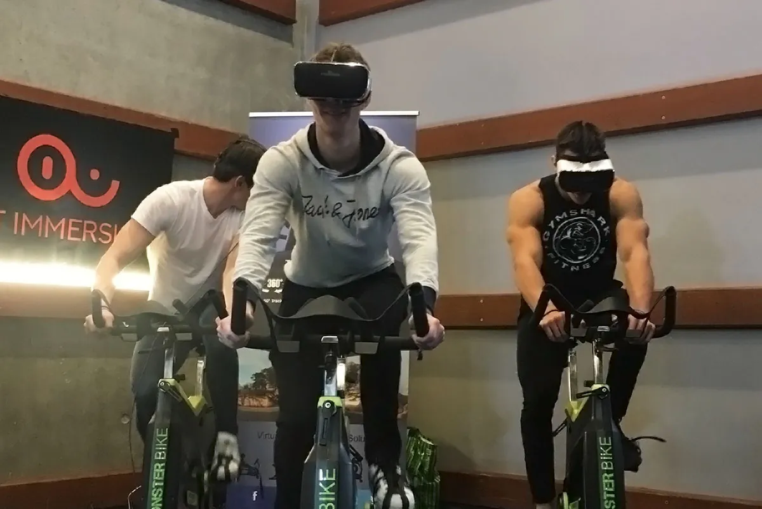
Thank You

